Slide 1
Chapter: Requirement Engineering

Slide 2
Requirements Engineering
Requirement: A function, constraint or other property that the system must provide to fill the needs of the system’s intended user(s)
Engineering: implies that systematic and repeatable techniques should be used
Requirement Engineering means that requirements for a product are defined, managed and tested systematically

Slide 3
Requirements Engineering
It is essential that the software engineering team understand the requirements of a problem before the team tries to solve the problem.
In some cases requirements engineering may be abbreviated, but it is never abandoned.
RE is software engineering actions that start with communication activity and continues into the modeling activity.
RE establishes a solid base for design and construction. Without it, resulting software has a high probability of not meeting customer needs.

Slide 4
Characteristics of a Good Requirement
Clear and Unambiguous
  standard structure
  has only one possible interpretation
  Not more than one requirement in one sentence
Correct
  A requirement contributes to a real need
Understandable
  A reader can easily understand the meaning of the requirement
Verifiable
  A requirement can be tested
Complete
Consistent
Traceable

Slide 5
Why is Getting Good Requirements Hard?
Stakeholders don’t know what they really want.
Stakeholders express requirements in their own terms.
Different stakeholders may have conflicting requirements.
Organisational and political factors may influence the system requirements.
The requirements change during the RE process. New stakeholders may emerge and the business environment change.

Slide 6
Requirements Engineering Tasks
Inception —Establish a basic understanding of the problem and the nature of the solution.
Elicitation —Draw out the requirements from stakeholders.
Elaboration (Highly structured)—Create an analysis model that represents information, functional, and behavioral aspects of the requirements.
Negotiation—Agree on a deliverable system that is realistic for developers and customers.
Specification—Describe the requirements formally or informally.
Validation —Review the requirement specification for errors, ambiguities, omissions, and conflicts.
Requirements management —Manage changing requirements.

Slide 7
Inception
Inception— Ask “context-free” questions that establish …
  Basic understanding of the problem
  The people who want a solution
  The nature of the solution that is desired, and
  The effectiveness of preliminary communication and collaboration between the customer and the developer

Slide 8
Elicitation
Elicitation - elicit requirements from customers, users and others.
  Find out from customers, users and others what the product objectives are
  what is to be done
  how the product fits into business needs, and
  how the product is used on a day to day basis

Slide 9
Why Requirement elicitation is difficult?
Problems of scope:
  The boundary of the system is ill-defined.
  Customers/users specify unnecessary technical detail that may confuse rather than clarify objectives.
Problem of understanding:
  Customers are not completely sure of what is needed.
  Customers have a poor understanding of the capabilities and limitations of the computing environment.
  Customers don’t have a full understanding of their problem domain.
  Customers have trouble communicating needs to the system engineer.
  Customers omit detail that is believed to be obvious.
  Customers specify requirements that conflict with other requirements.
  Customers specify requirements that are ambiguous or not able to test.
Problems of volatility:
  Requirement change over time.

Slide 10
Elaboration
Focuses on developing a refined technical model of software functions, features, and constraints using the information obtained during inception and elicitation
Create an analysis model that identifies data, function and behavioral requirements.
It is driven by the creation and refinement of user scenarios that describe how the end-user will interact with the system.
Each event parsed into extracted.
End result defines informational, functional and behavioral domain of the problem

Slide 11
Negotiation
Negotiation - agree on a deliverable system that is realistic for developers and customers
  Requirements are categorized and organized into subsets
  Relations among requirements identified
  Requirements reviewed for correctness
  Requirements prioritized based on customer needs
  Negotiation about requirements, project cost and project timeline.
  There should be no winner and no loser in effective negotiation.

Slide 12
Specification
Specification – Different things to different people.
It can be –
  Written Document
  A set of graphical models,
  A formal mathematical models
  Collection of usage scenario.
  A prototype
  Combination of above.
The Formality and format of a specification varies with the size and the complexity of the software to be built.
For large systems, written document, language descriptions, and graphical models may be the best approach.
For small systems or products, usage scenarios

Slide 13
Validation
Requirements Validation - formal technical review mechanism that looks for
  Errors in content or interpretation
  Areas where clarification may be required
  Missing information
  Inconsistencies (a major problem when large products or systems are engineered)
  Conflicting or unrealistic (unachievable) requirements.

Slide 14
Requirement Management
  Set of activities that help project team to identify, control, and track requirements and changes as project proceeds
  Requirements begin with identification. Each requirement is assigned a unique identifier. Once requirement have been identified, traceability table are developed.
  Traceability Table:
  Features traceability table - shows how requirements relate to customer observable features
  Source traceability table - identifies source of each requirement
  Dependency traceability table - indicate relations among requirements
  Subsystem traceability table - requirements categorized by subsystem
  Interface traceability table - shows requirement relations to internal and external interfaces
  It will help to track, if change in one requirement will affect different aspects of the system.

Slide 15
Initiating Requirements Engineering Process
Identify stakeholders
  Stakeholder can be “anyone who benefits in a direct or indirect way from the system which is being developed”
  Ex. Business manager, project manager, marketing people, software engineer, support engineer, end-users, internal-external customers, consultants, maintenance engineer.
  Each one of them has different view of the system.
Recognize multiple points of view
  Marketing group concern about feature and function to excite potential market. To sell easily in the market.
  Business manager concern about feature built within budget and will be ready to meet market.
  End user – Easy to learn and use.
  SE – product functioning at various infrastructure support.
  Support engineer – Maintainability of software.
Role of RE is to categorize all stakeholder information in a way that there could be no inconsistent or conflict requirement with one another

Slide 16
Work toward collaboration
  RE identify areas of commonality (i.e. Agreed requirement) and areas of conflict or inconsistency.
  It does not mean requirement defined by committee. It may happened they providing just view of their requirement.
  Business manager or senior technologist may make final decision.
Asking the first questions
  Who is behind the request for this work?
  Who will use the solution?
  What will be the economic benefit of a successful solution
  Is there another source for the solution that you need?
These questions will help – stakeholder interest in the software & measurable benefit of successful implementation.

Slide 17
Asking the question
Next set of questions – better understanding of the problem.
What business problem (s) will this solution address?
Describe business environment in which the solution will be used?
will performance or productivity issues affect the solution is approached?
Final set of questions – Effectiveness of communication
Are my questions relevant to the problem?
Am I asking too many questions?
Can anyone else provide additional information?
should I be asking you anything else?

Slide 18
Eliciting Requirement
Approach for eliciting requirement:
Collaborative Requirement Gathering
Quality Function Deployment
User Scenarios
Elicitation Work Products

Slide 19
Collaborative Requirement Gathering
Meetings are attended by all interested stakeholders.
Rules established for preparation and participation.
Agenda should be formal enough to cover all important points, but informal enough to encourage the free flow of ideas.
A facilitator controls the meeting.
A definition mechanism (blackboard, flip charts, etc.) is used.
During the meeting:
  The problem is identified.
  Elements of the solution are proposed.
  Different approaches are negotiated.
  A preliminary set of solution requirements are obtained.
  The atmosphere is collaborative and non-threatening.
Flow of event – Outline the sequence of events occurs
  Requirement gathering meeting ( initial meeting)
  During meeting
  Follow the meeting.

Slide 20
Collaborative requirement gathering (contd.)
In initial meeting, distribute “Product request” (defined by stakeholder) to all attendee.
Based on product request, each attendee is asked to make
  List of objects (Internal or external system objects)
  List of services( Processes or functions)
  List of constraints ( cost, size, business rules) and performance criteria( speed, accuracy) are developed.
Collect lists from everyone and combined.
Combined list eliminates redundant entries, add new ideas , but does not delete anything.
Objective is to develop a consensus list in each topic area (objects, services, constraints and performance).
Based on lists, team is divided into smaller sub-teams : each works to develop mini-specification for one or more entries on each of the lists.

Slide 21
Collaborative requirement gathering (Contd.)
Each sub-team the presents its mini-specification to all attendees for discussion. Addition, deletion and further elaboration are made.
Now each team makes a list of validation criteria for the product and present to team.
Finally, one or more participants is assigned the task of writing a complete draft specification.

Slide 22
Quality Function Deployment
It is a technique that translate the needs of the customer into technical requirement for software.
Concentrates on maximizing customer satisfaction.
QFD emphasizes – what is valuable to the customer and then deploys these values throughout the engineering process.
Three types of requirement:
Normal Requirements – reflect objectives and goals stated for product. If requirement are present in final products, customer is satisfied.
Expected Requirements – customer does not explicitly state them. Customer assumes it is implicitly available with the system.
Exciting Requirements- Features that go beyond the customer’s expectation.
During meeting with customer –
Function deployment determines the “value” of each function required of the system.
Information deployment identifies data objects and events and also tied with functions.
Task deployment examines the behavior of the system.
Value analysis determines the priority of requirements during these 3 deployments.

Slide 23
User Scenario
It is difficult to move into more software engineering activities until s/w team understands how these functions and features will be used by diff. end-users.
Developers and users create a set of usage threads for the system to be constructed
A use-case scenario is a story about how someone or something external to the software (known as an actor) interacts with the system.
Describe how the system will be used
Each scenario is described from the point-of-view of an “actor”—a person or device that interacts with the software in some way

Slide 24
Elicitation Work Products
Elicitation work product will vary depending upon the size of the system or product to be built.
Statement of need and feasibility.
Statement of scope.
List of participants in requirements elicitation.
Description of the system’s technical environment.
List of requirements and associated domain constraints.
List of usage scenarios.
Any prototypes developed to refine requirements.

Slide 25
Software Prototype
Prototype constructed for customer and developer assessment.
In some circumstances construction of prototype is require in beginning of analysis. (To derive requirement effectively)
Selecting Prototype Approach
Close ended (Throwaway Approach)
Open ended (Evolutionary Approach)
Close Ended – It serves as a rough demonstration of requirement. It is then discarded, and the software engineered using a different paradigm.
Open Ended - uses the prototype as the first part of an analysis activity that will be continued into design and construction. The prototype of the software is the first evolution of the finished system.

Slide 26
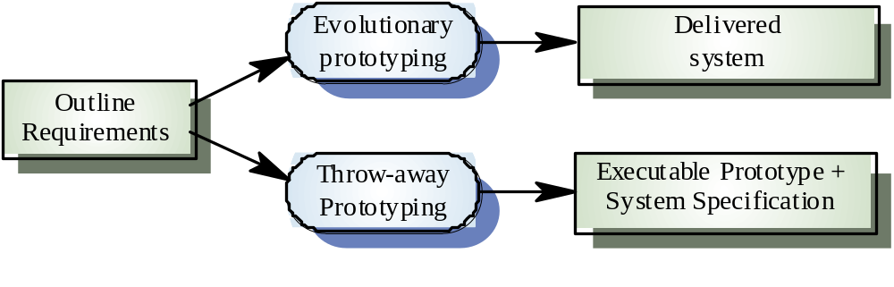
Approaches to prototyping

Slide 27
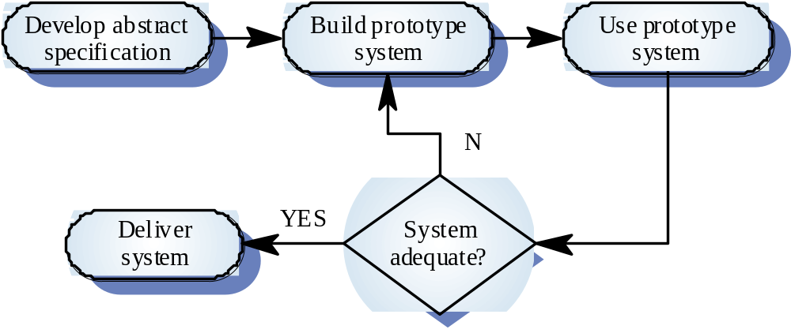
Evolutionary prototyping

Slide 28
Evolutionary prototyping advantages
Accelerated delivery of the system
  Rapid delivery and deployment are sometimes more important than functionality or long-term software maintainability
User engagement with the system
  Not only is the system more likely to meet user requirements, they are more likely to commit to the use of the system

Slide 29
Evolutionary prototyping problems
Management problems
  Existing management processes assume a waterfall model of development
  Specialist skills are required which may not be available in all development teams
Maintenance problems
  Continual change tends to corrupt system structure so long-term maintenance is expensive
Contractual problems
  Due to cost or time line agreed

Slide 30
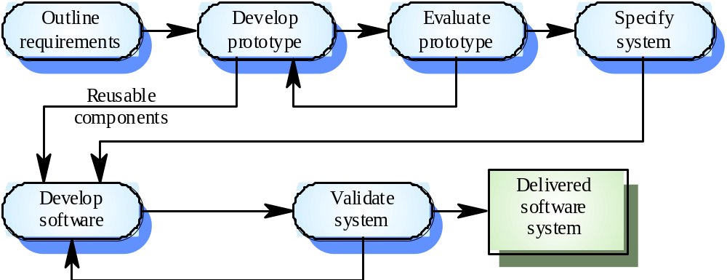
Throw-away prototyping

Slide 31
Throw-away prototyping
Used to reduce requirements risk
The prototype is developed from an initial specification, delivered for experiment then discarded
The throw-away prototype should NOT be considered as a final system
  Some system characteristics may have been left out
  There is no specification for long-term maintenance
  The system will be poorly structured and difficult to maintain

Slide 32
Prototyping Methods and Tools
A prototype must be developed rapidly so that the customer may assess results and recommend changes.
3 methods are available:
Fourth Generation Techniques (4GT)
  4GT enable the software engineer to generate executable code quickly, they are ideal for rapid prototyping.
  Ex. Tool for Database query language or reporting language.
Reusable software components
  To rapid prototyping is to assemble, rather than build, the prototype by using a set of existing software components.
  Should maintain library for existing software components
  An existing software product can be used as a prototype for a "new, improved" competitive product
Formal specification and prototyping environments
  Enable an analyst to interactively create language-based specifications of a system or software,
  Invoke automated tools that translate the language-based specifications into executable code,
  Enable the customer to use the prototype executable code to refine formal requirements.

Slide 33
Specification
Mode of specification has much to do with the quality of solution.
If specification incomplete, inconsistent, or misleading specifications have experienced the frustration and confusion that invariably results.
Specification Principles: May be viewed as representation process.
Separate functionality from implementation.
Develop a model of the desired behavior of a system.
Establish the context in which software operates by specifying the manner.
Define the environment in which the system operates and indicate how.

Slide 34
Specification Principles (cont.)
Create a cognitive model rather than a design or implementation model. The cognitive model describes a system as perceived by its user community.
The specifications must be tolerant of incompleteness and augmentable.
Establish the content and structure of a specification in a way that will enable it to be amenable to change.

Slide 35
Specification Representation
Representation format and content should be relevant to the problem.
  For example, a specification for a manufacturing automation system might use different symbology, diagrams and language than the specification for a programming language compiler.
Information contained within the specification should be nested (layered).
  Paragraph and diagram numbering schemes should indicate the level of detail that is being presented.
  It is sometimes worthwhile to present the same information at different levels of abstraction to aid in understanding.
Diagrams and other notational forms should be restricted in number and consistent in use.
  Confusing or inconsistent notation, whether graphical or symbolic, degrades understanding and fosters errors.
Representations should be revisable.

Slide 36
Software Requirements Specification
It contains a complete information description, a detailed functional description, a representation of system behavior, an indication of performance requirements and design constraints, appropriate validation criteria, and other information pertinent to requirements.
Format of SRS:
Introduction of the software requirements specification states the goals and objectives of the software, describing it in the context of the computer-based system.
Information content, flow, and structure are documented. Hardware, software, and human interfaces are described for external system elements and internal software functions.
Functional Description A processing narrative is provided for each function, design constraints are stated and justified & performance characteristics are stated
Behavioral Description operation of the software as a consequence of external events and internally generated control characteristics.

Slide 37
Software Requirements Specification (Cont.)
Validation Criteria is probably the most important and, ironically, the most often neglected section of the Software Requirements Specification (SRS). Testing or validating each user-scenario.
Finally, the specification includes a Bibliography and Appendix. The bibliography contains references to all documents that relate to the software. The appendix contains information that supplements the specifications

Slide 38
Specification Review
A review of the SRS (and/or prototype) is conducted by both the software developer and the customer.
Conducted at a macroscopic level
    Ensure that specification is complete
    Consistent
    Accurate (Information, functional and behavioral domain considered).
Review becomes more detailed while examining Information, functional and behavioral domain.
Examining not only broad descriptions but the way in which requirement worded.
E.g. Terms like “Vague ” (some, sometimes, often, usually) should be flag by reviewer for further clarification.

Slide 39
Review (cont.)
Once review is complete – SRS “signed off” by both customer and developer. ( “contract” for software development)
Requests for changes in requirements after the specification is finalized will not be eliminated.
Change is an extension of software scope and therefore can increase cost and/or delivery of product.
During the review, changes to the specification may be recommended.
It can be extremely difficult to assess the global impact of a change; that is, how a change in one function affects requirements for other functions

Slide 40
Chapter : Analysis Modeling

Slide 41
Requirements Analysis
Requirements analysis
  Specifies software’s operational characteristics
  Indicates software's interface with other system elements
  Establishes constraints that software must meet
Requirements analysis allows the software engineer (called an analyst or modeler in this role) to:
  Elaborate on basic requirements established during earlier requirement engineering tasks
  Build models that depict user scenarios, functional activities, problem classes and their relationships, system and class behavior, and the flow of data as it is transformed.
Throughout analysis modeling, the SE’s primary focus is on what not on how.
Analysis model and the requirements specification provide the developer and the customer with means to assess quality once software is built.

Slide 42
Analysis Modeling Principles
Analysis methods are related by a set of operational principles:
The information domain of a problem must be represented and understood.
The functions that are software performs must be defined.
The behavior of the software must be represented.
The models that depict information, function and behavior must be partitioned in a manner that uncovers detail in a layered fashion.
The analysis task should move from essential information toward implementation detail.

Slide 43
Analysis Modeling Principles
Information domain encompasses that the data flow into the system, out of the system and data stored.
Functions provide direct benefit to end-users and also provide internal support for those features that are user visible.
Behavior driven by its interaction with the external environment.
E.g. Input provided by end-users, control data provided by an external system, or monitoring data.

Slide 44
Analysis Modeling Principles
Key strategy of analysis model, divide complex problem into sub-problem until each sub-problem is relatively easy to understood. This concept is called partitioning.
The “essence” of the problem is described without any consideration of how a solution will be implemented.
E.g. Video game requires that player “instruct”
Implementation detail (design model) indicates how the essence will be implemented
E.g. Keyboard command might be typed or a joystick used.

Slide 45
Analysis Model Objectives
Three Primary Objectives:
  Describe what the customer requires.
  Establish a basis for the creation of a software design.
  Devise a set of requirements that can be validated once the software is built.
Its bridges the gap between a system-level description that describes overall system functionality and a software design.
Guidelines :
Graphics should be used whenever possible.
Differentiate between the logical (essential) and physical (implementation) considerations.
Develop a way to track and evaluate user interfaces.

Slide 46
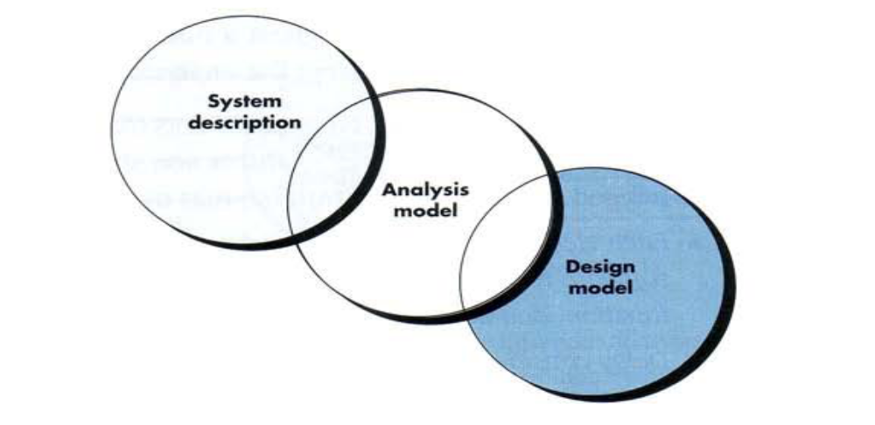
Analysis Model - A Bridge

Slide 47
Analysis Rules of Thumb
The model should focus on requirements that are visible within the problem or business domain. The level of abstraction should be relatively high. – Don’t get bogged into the details.
Each element of the analysis model should add to an overall understanding of software requirements and provide insight into the information domain, function and behavior of the system.
Delay consideration of infrastructure and other non-functional models until design.
Minimize coupling throughout the system. - If level of interconnectedness is high, efforts should be made to reduce it.
Assured that the analysis model provides value to all stakeholders. – business stakeholder should validate requirement, Designers should use the model as a basis for design.
Keep the model as simple as it can be. - No need to use additional diagram and use notations.

Slide 48
Elements of Analysis model
There are two approaches
  Structured Analysis:-
    Data objects are modeled in a way that defines their attributes and relationships.
    Processes that manipulate data objects in a manner that shows how they transform data as data objects flow through the systems.
  Object Oriented Analysis :-
    Focuses on the definition of classes and the manner in which they collaborate with one another.
    UML is predominantly object oriented.

Slide 49
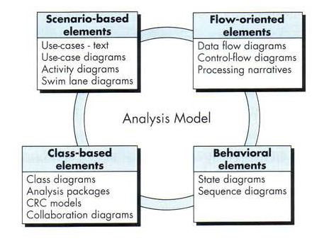
Elements of Analysis model

Slide 50
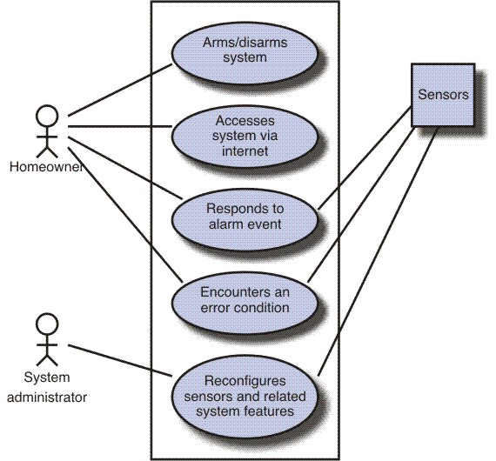
Scenario Based diagram
Scenario-based elements
  Use-case—How external actors interact with the system (use-case diagrams; detailed templates)
  Functional—How software functions are processed in the system (flow charts; activity diagrams)
  Activity – can be represented at many diff. level of abstraction.

Slide 51
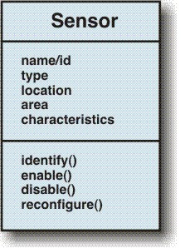
Class diagram for sensor
Class-based elements
  The various system objects (obtained from scenarios) including their attributes and functions (class diagram)

Slide 52
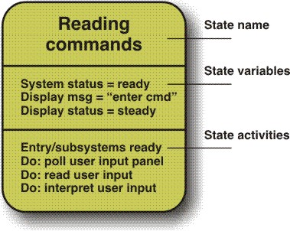
Behavioral Element – State Diagram
Behavioral elements
  How the system behaves in response to different events (state diagram)

Slide 53
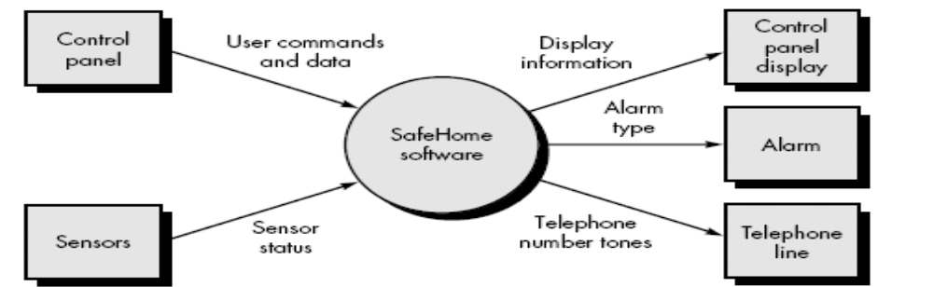
Flow-oriented elements
Flow-oriented elements
  How information is transformed as if flows through the system (data flow diagram)
  System accepts input in a variety forms; applies functions to transform it; and produces output in variety forms.

Slide 54
Scenario based Modeling
Creating a Preliminary use case
use case describes a specific usage scenario in straightforward language from the point of view of a defined actor. But how do you know
(1) what to write about, (2) how much to write about it, (3) how detailed to make your description, and (4) how to organize the description? These are the questions that must be answered if use cases are to provide value as a requirements modeling tool.

Slide 55
Scenario based Modeling
Refining a Preliminary Use Case
A description of alternative interactions is essential for a complete understanding of the function that is being described by a use case. Therefore, each step in the primary scenario is evaluated by asking the following questions [Sch98a]:
• Can the actor take some other action at this point?
• Is it possible that the actor will encounter some error condition at this point? If
so, what might it be?
• Is it possible that the actor will encounter some other behavior at this point (e.g., behavior that is invoked by some event outside the actor’s control)? If so, what might it be?

Slide 56
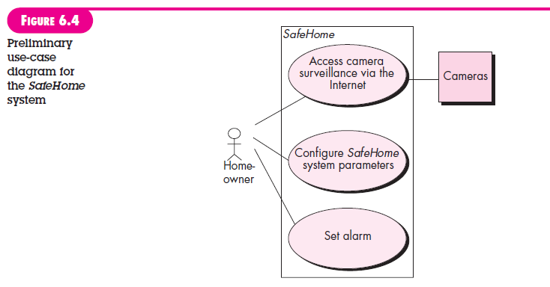
Scenario based Modeling

Slide 57
Data Modeling
Analysis model often begin with data modeling.
Data model consists of three interrelated pieces of information:
  The data object,
  The attributes that describe the data object, and
  The relationships that connect data objects to one another.

Slide 58
Data Object
A data object is a representation of almost any composite information that must be understood by software.
composite information - number of different properties or attributes.
A data object can be:-
  An external entity (e.g., anything that produces or consumes information),
  A thing (e.g., a report or a display),
  An occurrence (e.g., a telephone call)
  Event (e.g., an alarm),
  A role (e.g., salesperson),
  An organizational unit (e.g., accounting department),
  A place (e.g., a warehouse),
  A structure (e.g., a file).

Slide 59
Data Attributes
Define the properties of a data object.
Attributes name a data object, describe its characteristics, and in some cases, make reference to another object.
In addition, one or more of the attributes must be defined as an identifier( Key value or Unique value).
Ex. Data object Car has Id number as identifier.

Slide 60
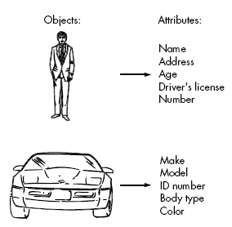
For Ex.- Set of attributes can be defined for a person or a car (i.e. Data Object)

Slide 61
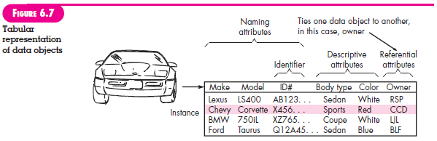

Slide 62
Relationships
Data objects are connected to one another in different ways.
Figure 6.8a. A connection is established between person and car because the two objects are related.
For example,
• A person owns a car.
• A person is insured to drive a car.
The relationships owns and insured to drive define the relevant connections between person and car.
Figure 6.8b illustrates these object-relationship pairs graphically.
The arrows noted in Figure 6.8b provide important information about the directionality of the relationship and often reduce ambiguity or misinterpretations.

Slide 63
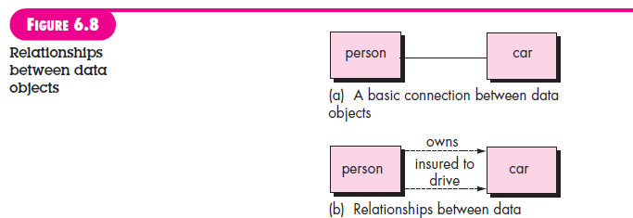
Relationships

Slide 64
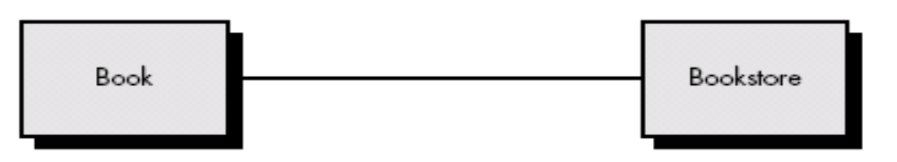
Relationships
Consider two data objects
    Book
    Bookstore
A connection is established between book and bookstore because the two objects are related.

Slide 65
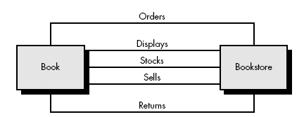
Relationship
To determine relationship between them, must understand the role of book and bookstore.
For Example:
  A bookstore orders books.
  A bookstore displays books.
  A bookstore stocks books.
  A bookstore sells books.
  A bookstore returns books.

Slide 66
Cardinality and Modality
Additional element of data modeling.
Object X relates to object Y does not provide enough information.
How many occurrences of object X are related to how many occurrences of object Y called cardinality.

Slide 67
Cardinality
Representing the number of occurrences objects in a given relationship.
Cardinality is the specification of the number of occurrences of one [object] that can be related to the number of occurrences of another.
Cardinality is usually expressed as simply 'one' or 'many’.
1:1 – One object can relate to only one other object.
1:M – one object can relate to many objects.
M:N – Some no. of occurrences of an object can relate to some other no. of occurrences of another object.

Slide 68
Modality
Cardinality does not provide an indication of whether or not a particular data object must participate in the relationship.
Modality of a relationship is 0 if there is no explicit need for the relationship to occur or the relationship is optional.
The modality is 1 if an occurrences of the relationship is mandatory.

Slide 69
Class based modeling
Class-based modeling represents the objects that the system will manipulate, the operations (also called methods or services) that will be applied to the objects to effect the manipulation, relationships (some hierarchical) between the objects, and the collaborations that occur between the classes that are defined.
The elements of a class-based model include classes and objects, attributes, operations, class responsibility-
collaborator (CRC) models, collaboration diagrams, and packages.

Slide 70
Class based modeling
Identifying Analysis Classes
Specifying Attributes
Defining operations
CRC modeling

Slide 71
Identifying Analysis classes
Identify classes by examining the problem statement or by performing a “Grammatical Parse” on the use-cases or processing narratives developed for the system.
How do analysis classes manifest?
External entities (other system, people, devices) that produce or consume information
Things (reports, display, signals) that are part of the information domain for the problem.
Occurrences or events – occur within the context of system operations.

Slide 72
Analysis classes (cont.)
Roles ( manager, engineer, salesperson) played by people who interact with the system.
Organizational units (Division, group, team) that are relevant to an application,
Places – establish the context of the problem and overall function of the system.
Structures (sensors, computers) that define a class of objects or related classes of objects.

Slide 73
Selecting Criteria - Classes
Retained Information – Potential class must be remembered so that system can function.
Needed Services – Must have set of identifiable operations that can change the value of its attributes.
Multiple Attributes – A class with single attribute may, in fact, be useful during design, but probably better represented as an attributes of another class.
Common Attributes – These attributes apply to all instances of the class

Slide 74
Selecting Criteria - Classes
Common operations - A set of operations can be defined for the potential class and these operations apply to all instances of the class.
Essential requirements - External entities that appear in the problem space and produce or consume information essential to the operation of any solution for the system will almost always be defined as classes in the requirements model.

Slide 75
Specifying Attributes
Attributes are the set of data objects that fully define the class within the context of the problem.
To develop attributes for class, a s/w can study use-case and select those “things” that reasonably “Belong” to the class.

Slide 76
Defining operations
Operations define the behavior of an object.
Four broad categories
  Operations that manipulate data in some way.
  Operations that perform a computation.
  Operations that inquire about the state of an object
  Operations that monitor an object for the occurrence of the controlling event.
To derive a set of operations, analyst study a use-case( or narrative) and select those operations that reasonably belongs.

Slide 77
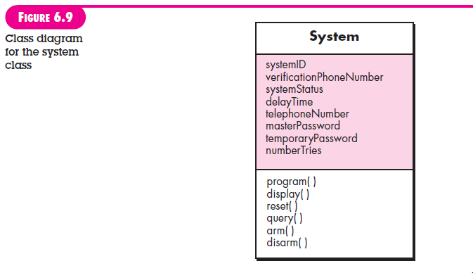
Defining operations

Slide 78
Class-Responsibility-collaborator (CRC) modeling
Simple means for identifying and organizing the classes that are relevant to system or product requirement.
A CRC model is a collection of standard index cards that represent classes. Cards are divided into three sections.
    Top of the cards write class name
    In the body, list the class responsibility on left.
    Collaborator on the right
It make use of actual or virtual index cards.

Slide 79
CRC – Classes Instantiation
Three types classes:
  Entity Classes (model or business classes):- Represent things that are to be stored in a database and persist throughout the duration of the application.
  Boundary class:- used to create interface. It designed with the responsibility of managing the way entity objects are represented to users.
  Controller Class:- manage a “unit of work” from start to finish.
    Creation or update of entity objects.
    Representation of boundary objects as they obtain information from entity objects.
    Complex communication between sets of objects.
    Validation of data.

Slide 80
Responsibility – CRC modeling
Guideline for allocating responsibility to classes:
System intelligence should be distributed across classes to best address the needs of the problem.
Each responsibility should be stated as generally as possible.
Information and the behavior related to it should reside within the same class.
Information about one thing should be localized with single class, not distributed across multiple classes.
Responsibility should be shared among related classes, when appropriate.

Slide 81
Collaborations – CRC modeling
Collaborations represent request from client to server in fulfillment of a client responsibility.
Ex. One object collaborate with another object if it needs to send some msg to other object.
It identifying relationships between objects.
Collaborations are identified by determining whether a class can fulfill each responsibility itself. If it cannot, then it needs to interact with another class.

Slide 82
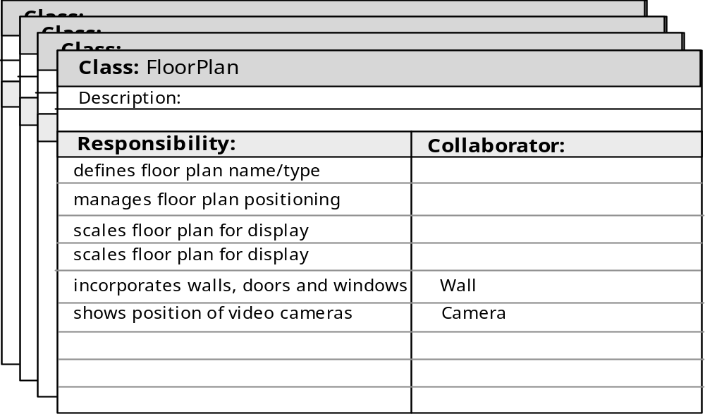
CRC modeling

Slide 83
Reviewing CRC model
All participants in the review (of the CRC model) are given a subset of the CRC model index cards.
  Cards that collaborate should be separated (i.e., no reviewer should have two cards that collaborate).
All use-case scenarios (and corresponding use-case diagrams) should be organized into categories.
The review leader reads the use-case deliberately.
  As the review leader comes to a named object, she passes a token to the person holding the corresponding class index card.

Slide 84
Cont.
When the token is passed, the holder of the class card is asked to describe the responsibilities noted on the card.
  The group determines whether one (or more) of the responsibilities satisfies the use-case requirement.
If the responsibilities and collaborations noted on the index cards cannot accommodate the use-case, modifications are made to the cards.
  This may include the definition of new classes (and corresponding CRC index cards) or the specification of new or revised responsibilities or collaborations on existing cards.

Slide 85
Function Modeling & Information Flow
Information is transformed as it flows through a computer-based system. The system accepts input in a variety of forms; applies hardware, software, and human elements to transform it; and produces output in a variety of forms
Structured analysis began as an information flow modeling technique.
A rectangle is used to represent an external entity (software, hardware, a person)
A circle (sometimes called a bubble) represents a process or transform that is applied to data (or control) and changes it in some way.

Slide 86
Function Modeling & Information Flow
An arrow represents one or more data items (data objects) and it should be labeled.
The double line represents a data store—stored information that is used by the software.
First data flow model (sometimes called a level 0 DFD or context diagram) represents the entire system.
It provides incremental detail with each subsequent level.

Slide 87
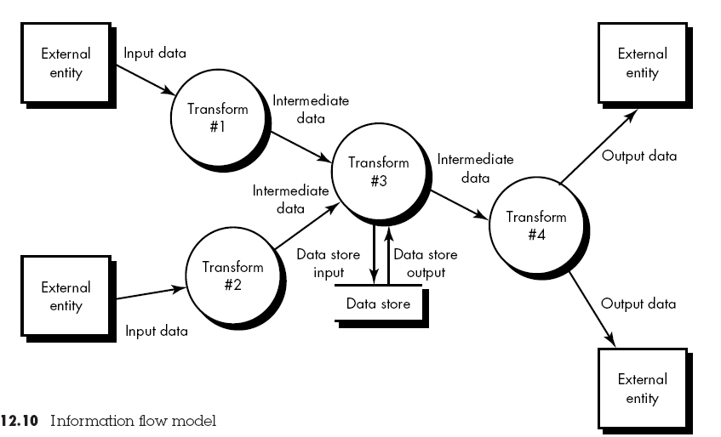
Information Flow model

Slide 88
Creating a Data Flow Model
It enables software engineer to develop models of the information domain and functional domain at the same time.
Data flow diagram may be used to represent a system or software at any level of abstraction
As DFD is refined into greater levels of detail, the analyst performs an implicit functional decomposition of the system.
As DFD refinement results in corresponding refinement of data as it moves through the processes that represent the application

Slide 89
DFD Guidelines
Depict the system as single bubble in level 0.
Primary input and output should be carefully noted
Refine by isolating candidate processes and their associated, data objects and data stores
All arrows and bubbles should be labeled with meaningful names.
Information flow continuity must be maintained from level to level.
One bubble at a time should be refined.

Slide 90
Data flow models
A level 0 DFD, also called a fundamental system model or a context model, represents the entire software element as a single bubble with input and output data indicated by incoming and outgoing arrows.
Level 0 DFD refinement into level 1 DFD with all relevant processes to the system.
Level 1 DFD each processes can be refined into level 2 DFD.
Refinement of DFD continues until each bubble performs a simple function.

Slide 91
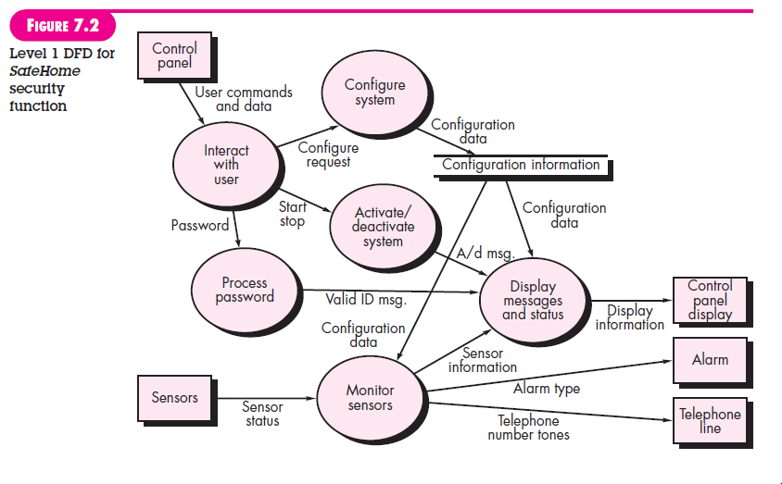
Data flow models

Slide 92
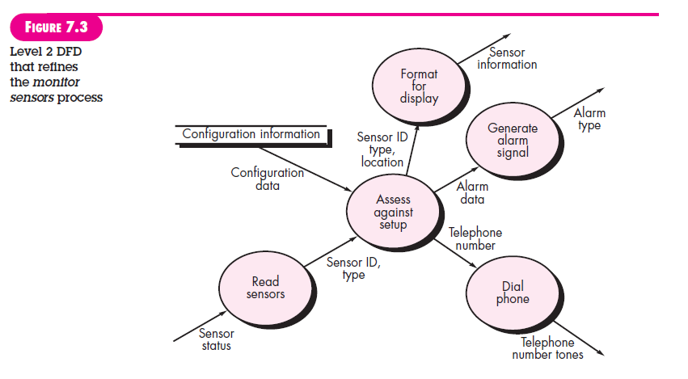
Data flow models

Slide 93
Control flow model
Application which contains collection of classes are dependent on event rather than data, produce control information rather than reports or displays.
Such application require the use of control flow modeling in addition to data flow modeling.

Slide 94
Guideline for control flow
List all processes that are performed by the software.
List all the interrupt conditions.
List all activities that are performed by operator or actor.
List all data conditions.
Review all the “Control items” as possible for control flow inputs / outputs.
Describe the behavior of a system by identifying its states; identify how each state is reached; define the transitions between states.
Focus on possible omission – a very common error in specifying control

Slide 95
Control Specification (CSPEC)
CSPEC represent the behavior of the system in two different ways.
It contains a state diagram – sequential specification of behavior.
It also contain program activation table – combinatorial specification of behavior.
By reviewing the state diagram, a software engineer can determine the behavior of the system and can discover whether there are “holes” in specified behavior.
CSPEC describe the behavior of the system, but it gives us no information about the inner working of the processes that activated result.

Slide 96
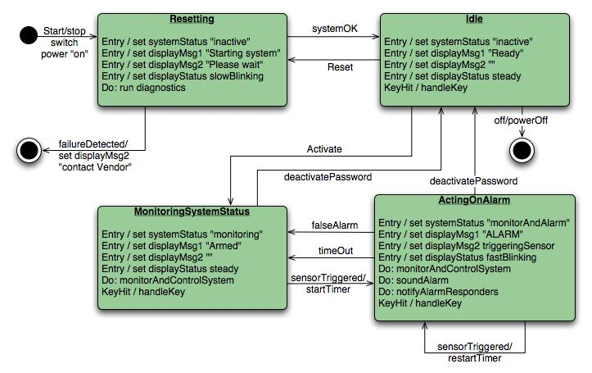


Slide 97
Process Specification (PSPEC)
Used to describe all flow model processes that appear at the final level of refinement.
It include narrative text, a program design language (PDL) description of the process algorithm, mathematical equations, tables, diagrams or charts.
By providing a PSPEC to accompany each bubble in the flow model, the software engineer creates a “mini-spec” that can serve as guide for design of the software component that will implement the process.

Slide 98
Behavioral Modeling
Behavioral model indicates how software will respond to external events.
To create model –
  Evaluate all use cases to understand the sequence of interaction within the system.
  Identify events
  Create sequence for each use-case
  Build a state diagram for the system.
  Review the behavioral model to verify accuracy or consistency.

Slide 99
Identifying events with the use-cases
Use-case represents a sequence of activities that involves actors and the system.
An event occurs whenever the system and an actor exchange information.
An event is not the information that has been exchanged, but rather the fact that information has been exchanged.
An actor should be identified for each event.
Information that is exchanged should be noted.
Any conditions or constraints should be listed.

Slide 100
State Representation
2 diff. characteristics should be considered.
  Passive State
  Active State
Passive state is simply the current status of all of an object’s attributes.
Ex. Player – class
current position and orientation – attributes.
Active State is current state of the object as it undergoes a continuing transformation or processing.
Ex. Player – class
active state – moving, injured, trapped, lost etc.
An event must occur to force an object to make a transition from one active state to another.

Slide 101
State diagram for analysis classes
UML state diagram that represents active states for each class and events that causes changes between these active state.

Slide 102
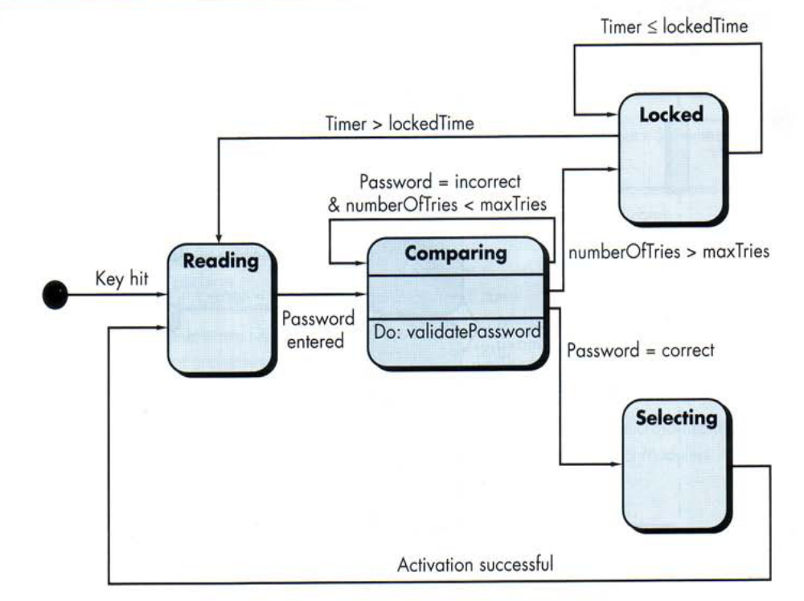

Slide 103
An action occurs concurrently with the state transition or as a sequence of it and generally involves one or more operations of the object.

Slide 104
Sequence diagram
It indicates how events cause transitions from object to object .
Once event have identified by examining a use-cases, the modeler creates a sequence diagram.
It representation of how events cause flow from one objects to another as function of time.
Its shorthand version of use-case diagram that represent key classes and the events that cause behavior to flow from class to class.
System objects and events will help in creation of effective design.

Slide 105
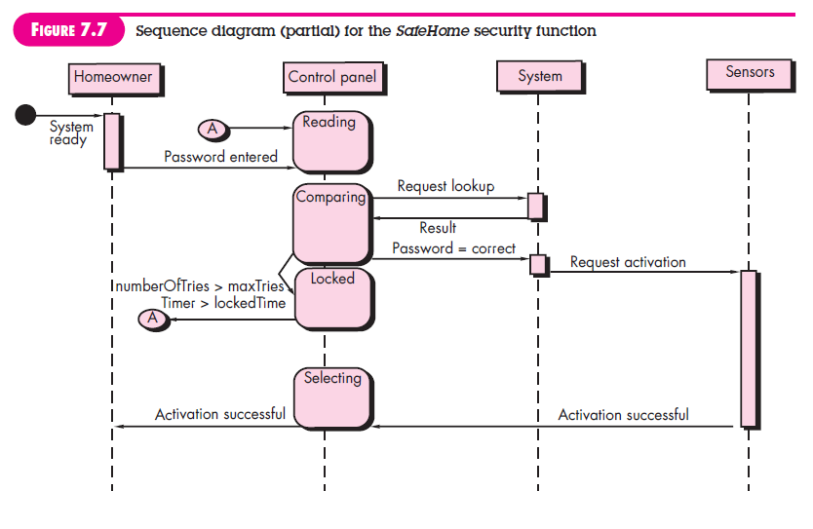
Sequence diagram

